Slide 1

Text-based Cyber Threat Detection
Machine Learning for Malicious Text Classification
Authors: Kelvin Kipkorir, Lucy Mutua, Charles Mutembei, Sharon Aoko, Victor Musyoki

Slide 2
Problem Statement
Rising text-based threats (phishing, malware-laced reports).
Manual detection is inefficient; rule-based systems fail to adapt.
Goal: Automate classification of text as malicious or benign. Visual:

Slide 3
Objectives
Primary Goal:
Develop a machine learning model to classify cybersecurity text as malicious or benign.
Technical Approach:
Leverage NLP techniques (tokenization, lemmatization) for text preprocessing.
Train and evaluate neural networks (NN, LSTM, BiLSTM) for threat detection.
Outcome Metrics:
Achieve high accuracy (>90%) with balanced precision/recall.
Enable scalable, automated analysis of unstructured threat data.
Why these objectives will work:
They have a clear scope: Focuses on the what (classification), how (NLP + ML), and success criteria (metrics).
The solution is audience-friendly: Avoids jargon; aligns with both technical and non-technical stakeholders.
Provision of visualization: Icons/flowcharts make the objectives memorable.

Slide 4

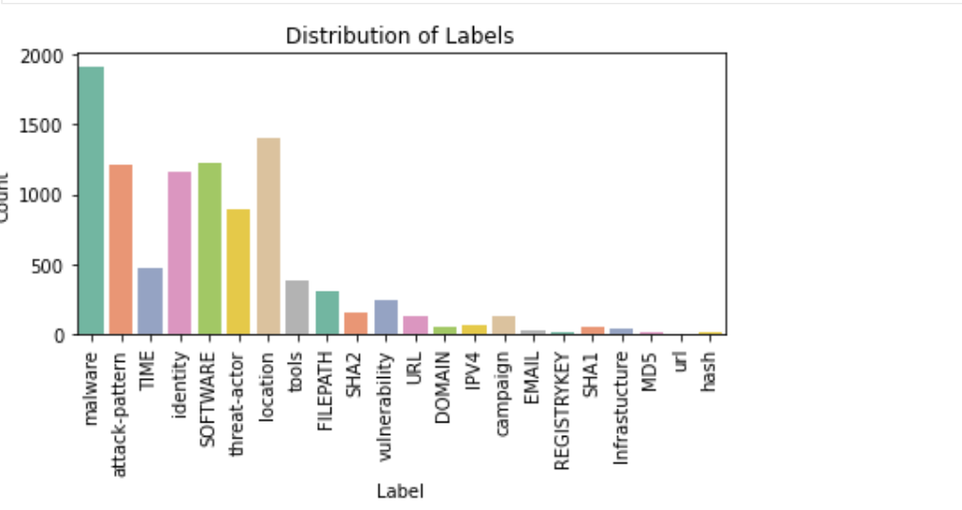
Data Understanding
Source: Kaggle (19,000+ entries).
Features: Raw text + entities (malware, tools, locations).
Labels: malicious (9,938 samples) vs. benign (10,002).

Slide 5
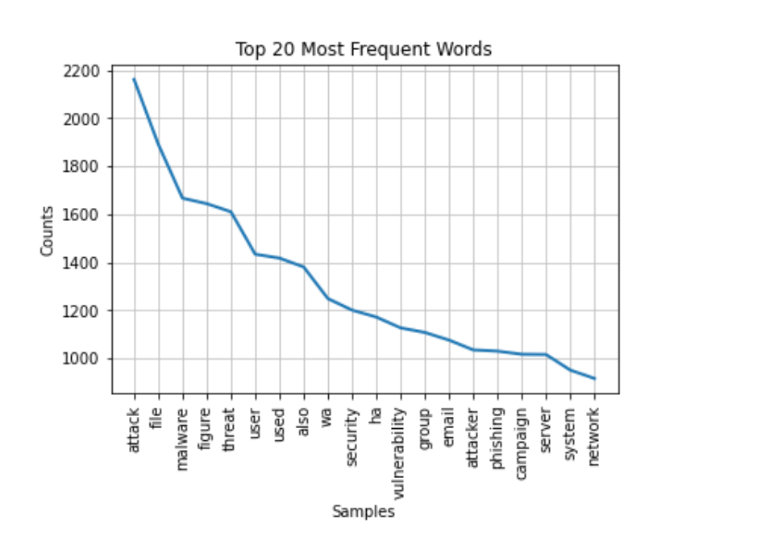
Data Preprocessing
Cleaning & Preparing Text Data
Steps:
Lowercasing, punctuation removal.
Tokenization + lemmatization.
Stopword removal.
Padding sequences (max length = 250 tokens).

Slide 6

Model Architectures
1. Baseline NN: Embedding → Flatten → Dense (95.3% value accuracy).
2. Tuned NN: Added dropout + extra dense layers (95.2% value accuracy).
3. LSTM: Poor performance (50% accuracy).
5. Bidirectional LSTM: Best results (95.3% value accuracy).

Slide 7
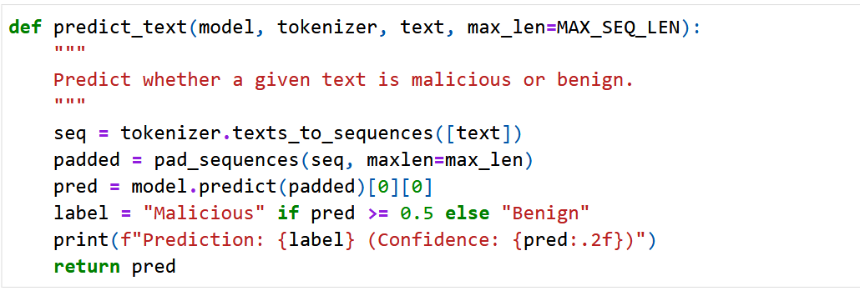
Real-World Test
Input: The malware downloads payloads and steals credentials.
All models misclassified as benign (false negative).
Highlights need for confidence thresholds and more training data.

Slide 8
Challenges & Lessons
Challenges:
LSTM’s failure (possible causes: insufficient tuning/data).
False negatives in predictions.
Lessons:
Bidirectional models capture context better.
Dropout prevents overfitting.

Slide 9
Future Work
Experiment with Transformer Models
We should aim to test with transformer models such as BERT or DistilBERT for improved contextual understanding.
We should fine-tune on cybersecurity-specific text example threat reports, phishing emails to enhance accuracy for future.
Enhancement of Dataset Quality
We should address false negatives by adding adversarial examples example obfuscated malware descriptions.
We should include diverse threat types such as zero-day exploits, social engineering tactics, multilingual attacks.
We should balance class distribution to reflect real-world scenarios for instance higher benign-to-malicious ratios.
Deploy Bidirectional LSTM (BiLSTM) with Feedback
We should consider integrating the model into a user-friendly dashboard for security analysts.
We should also implement a feedback loop to collect analyst corrections and iteratively improve the model.
Additional Improvements
We should consider confidence thresholds that is flag low-confidence predictions for human review.
We should consider real-time monitoring to adapt to evolving threats via continuous learning.

Slide 10
Conclusion and Recommendations
Conclusion
Recommendations
Success Achieved:
We managed to developed a prototype with 95.3% accurate Bidirectional LSTM model for text-based threat detection.
We were able to demonstrated that NLP and deep learning can automate classification of malicious/benign text effectively.
Challenges Addressed:
We overcame dataset limitations such as missing labels, class balance through careful preprocessing.
We validated that sequential models (BiLSTM) outperform traditional NNs for contextual analysis.
Real-World Impact:
We discovered there is potential to reduce analysts’ workload by filtering benign content.
We found out there is scalable solution for processing unstructured threat data such as emails, reports, logs.
Data Enhancements:
Collaborate with threat intelligence teams to expand dataset diversity for example dark web text, non-English threats. Implement continuous data labelling to keep the model updated.
Deployment Strategy:
Integrate the BiLSTM model into a SOC (Security Operations Centre) workflow as a first-pass filter. Design a feedback UI for analysts to correct misclassifications (active learning).
Monitoring & Maintenance:
Track model drift with real-time performance metrics. Schedule quarterly retraining with new threat data.

Slide 11

Thank You
Group 10
https://github.com/kkipkorir/cyber-threat-intelligence

